Slide 1


Fostering the representation of African cultures in Wikipedia language editions…
Dr. Marc Miquel
{marcmiquel@gmail.com}
Username:marcmiquel
Pompeu Fabra University, Barcelona, Catalonia
Amical Wikimedia (Catalan Wikipedia)
March 18th 2018 Tunis

Slide 2
…with Wikipedia Cultural Diversity Observatory (WCDO)
Dr. Marc Miquel
{marcmiquel@gmail.com}
Username:marcmiquel
Pompeu Fabra University, Barcelona, Catalonia
Amical Wikimedia (Catalan Wikipedia)
March 18th 2018 Tunis

Slide 3

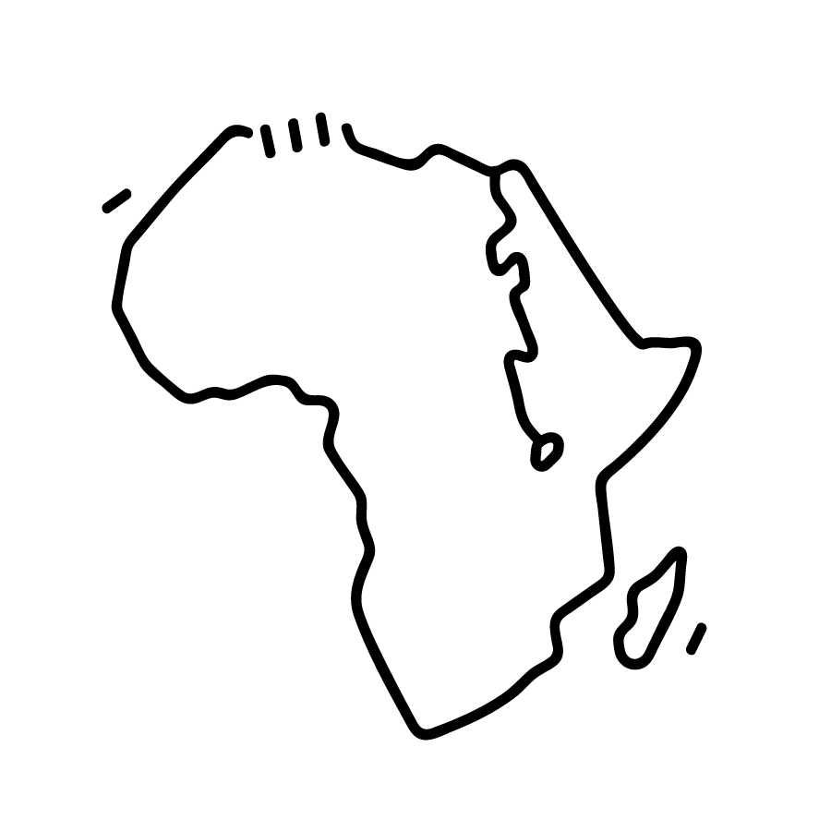
1. The Problem
There are only 25 Wikipedia language editions originary from Africa.
They account for the 0.35% of all the Wikipedia articles, or 1.5% if we include Arabic in the list. Many more if we include French...

Slide 4
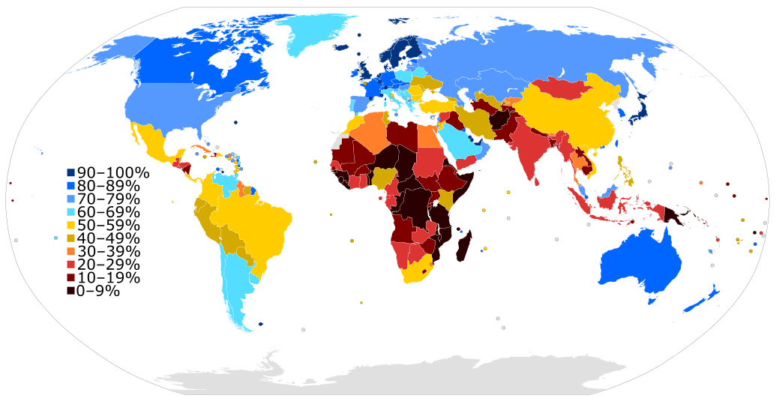
We know that this is due to many factors such as the digital divide, language reputation, among others.
Van Dijk, Z. (2009). Wikipedia and lesser-resourced languages. Language Problems and Language Planning, 33(3), 234-250.

Slide 5
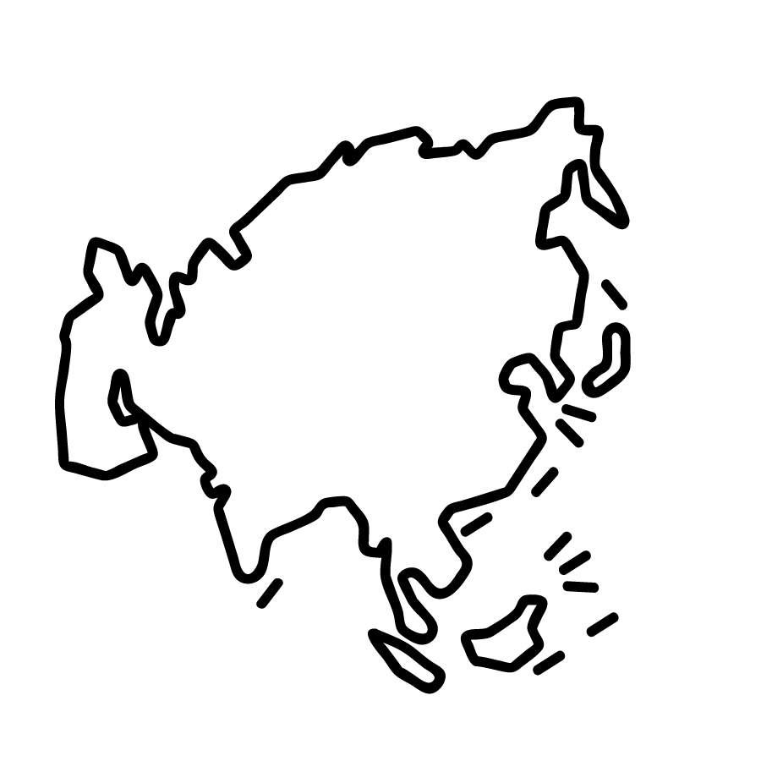
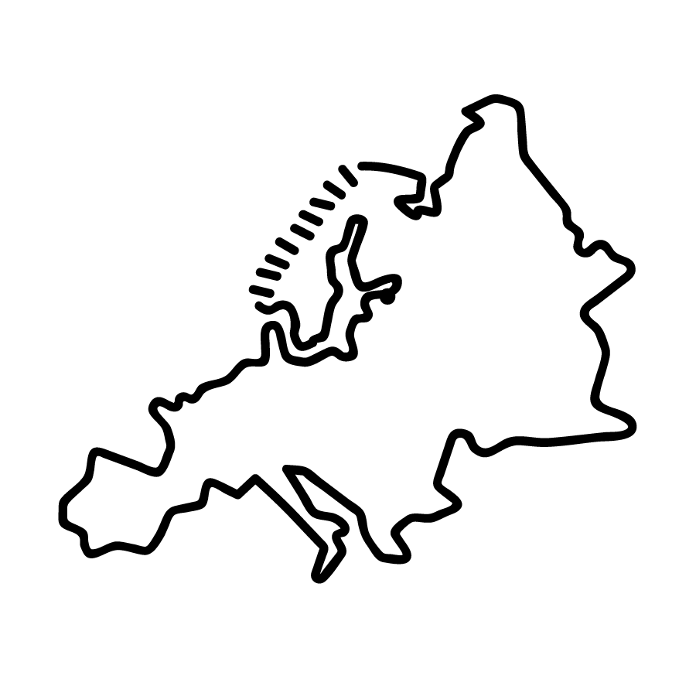


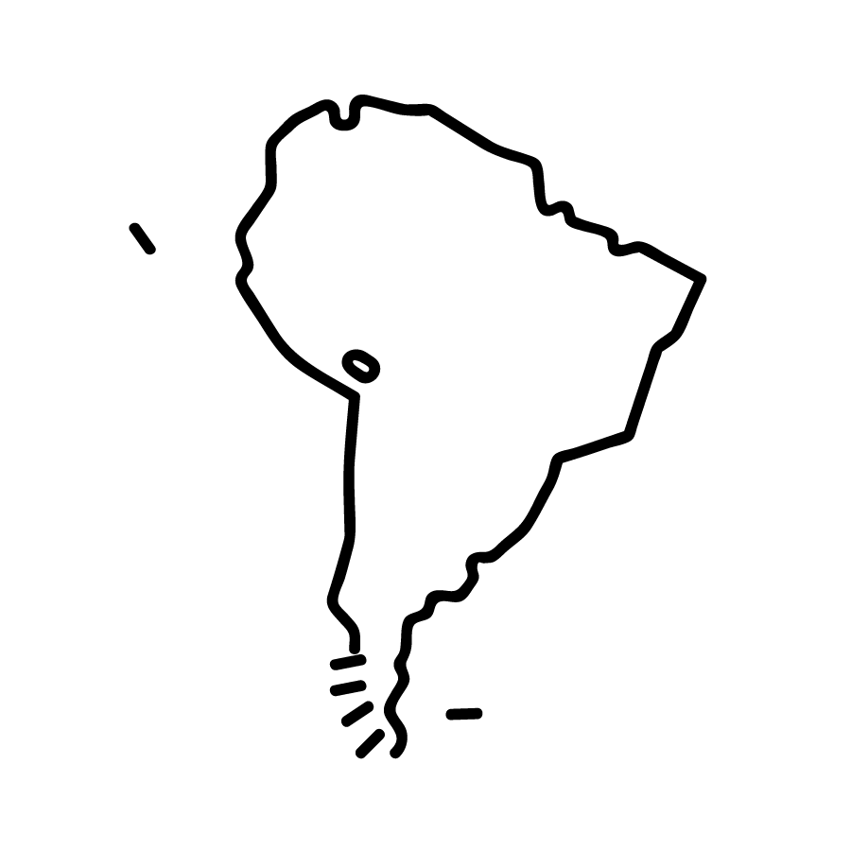
Wikipedia project does not reflect well enough the world’s cultural diversity.
First, because that many articles that should describe the world’s cultural diversity do not exist due to the mentioned reasons.
Second, because there exists some language gaps: Wikipedias do not cover each others content.

Slide 6
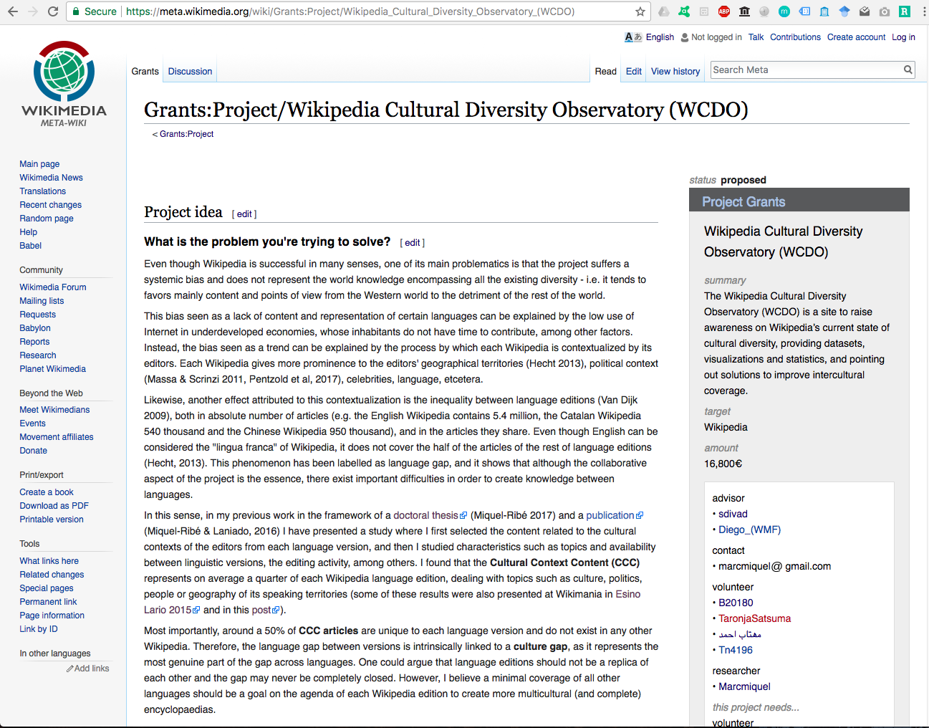
2. Proposed Solution
Wikipedia Cultural Diversity Observatory (WCDO).
Project aimed at raising awareness on the current state of cultural diversity in each language and, at the same time, providing tools to improve interlanguage collaboration for intercultural coverage.
https://meta.wikimedia.org/wiki/Grants:Project/Wikipedia_Cultural_Diversity_Observatory_(WCDO)
Notes:
For this, I propose to create a site named Wikipedia Cultural Diversity Observatory (WCDO), where to provide automated rich statistics and visualizations on the current state of diversity, cultural context content datasets for each language edition as well as pointing out solutions in order to improve the exchange of content across Wikipedia language editions.
One important solution is a list of articles for each Wikipedia language edition CCC by order of priority (algorithmically computed according to valuable metrics such as extension, quality and editor engagement metrics) which should exist in any other Wikipedia language edition. The list could highlight the first 100, although big Wikipedias may have more than 100 articles which should be reasonably present in all other languages.
This Top 100 in particular would ensure that each Wikipedia language edition has a minimal and strategical coverage of the whole available Wikipedia project cultural diversity.

Slide 7
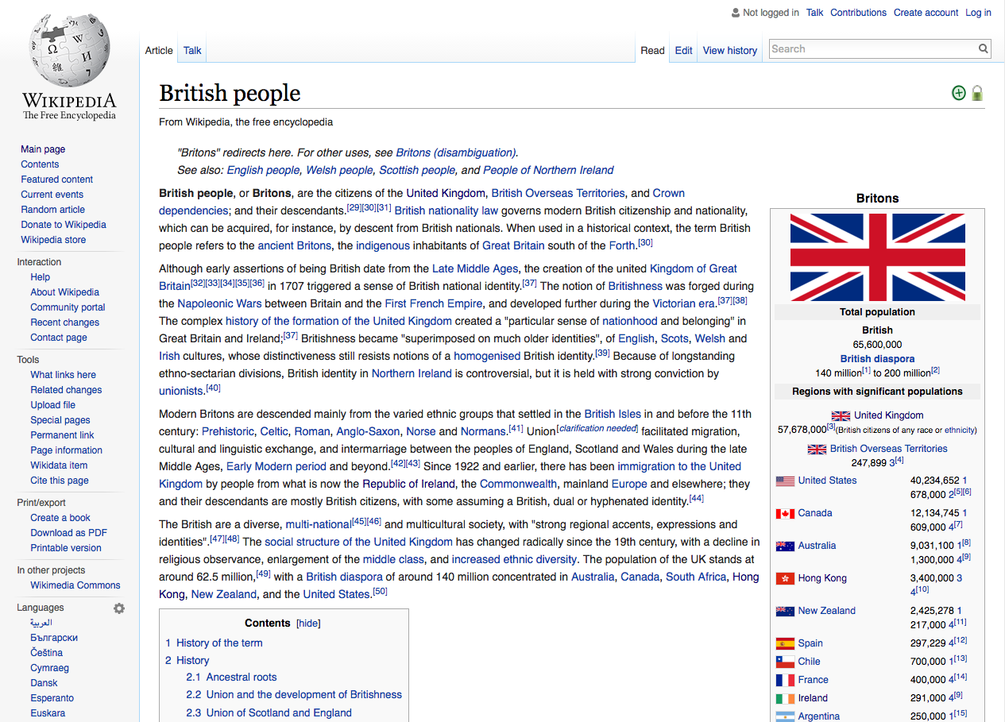
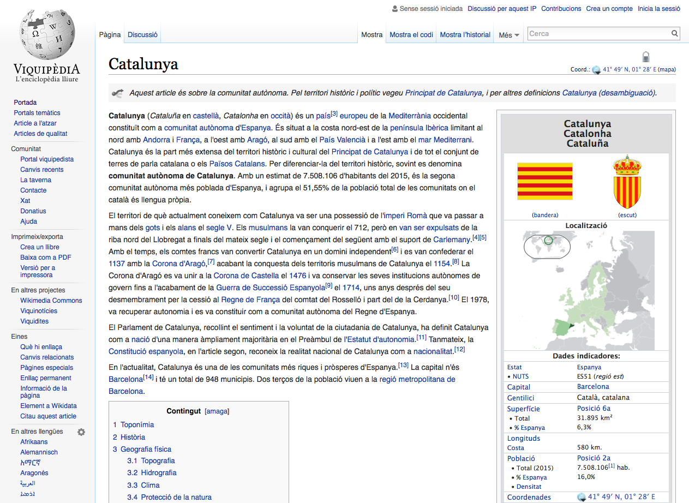
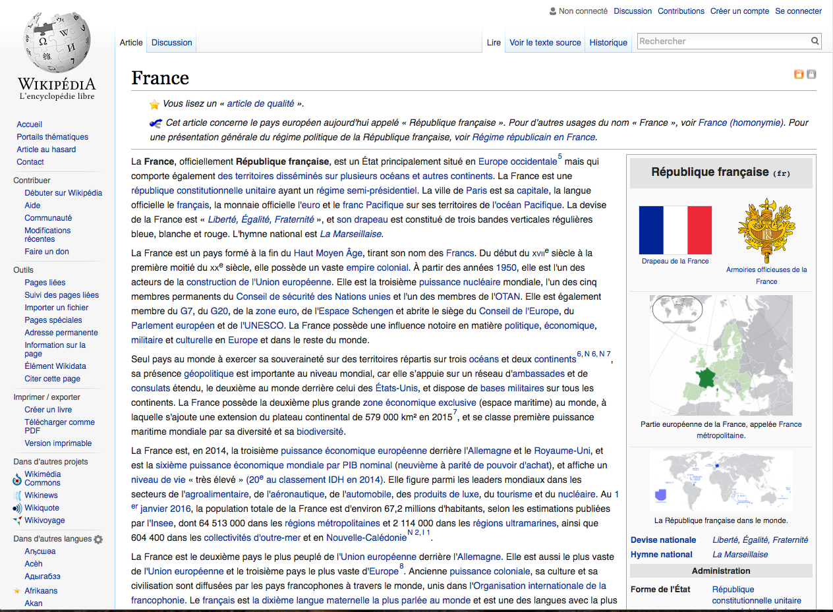
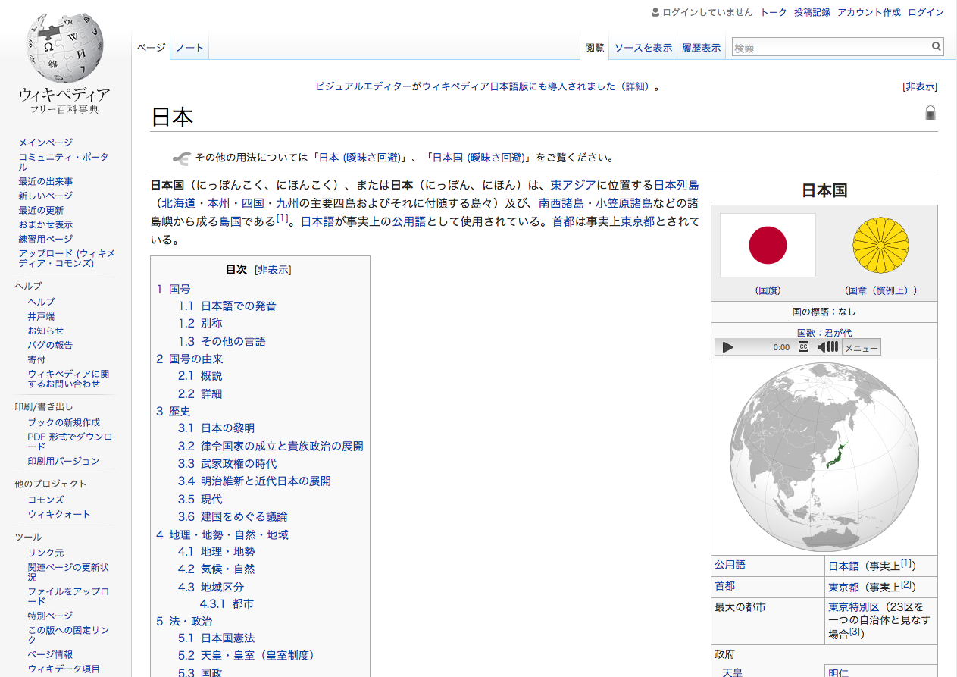
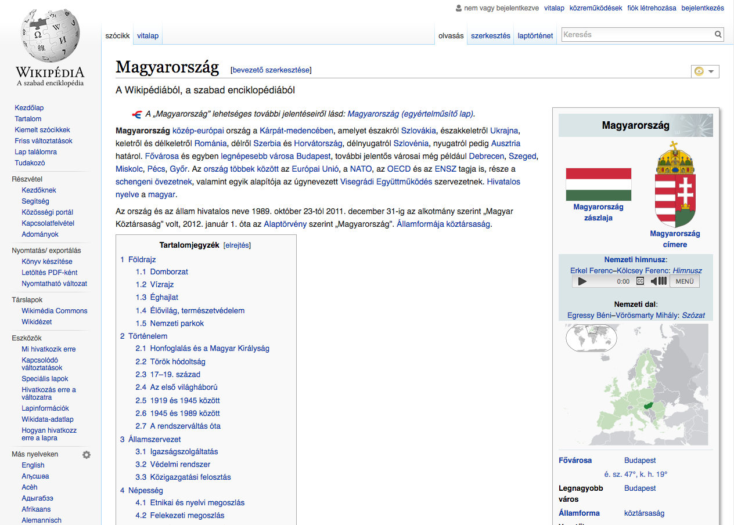
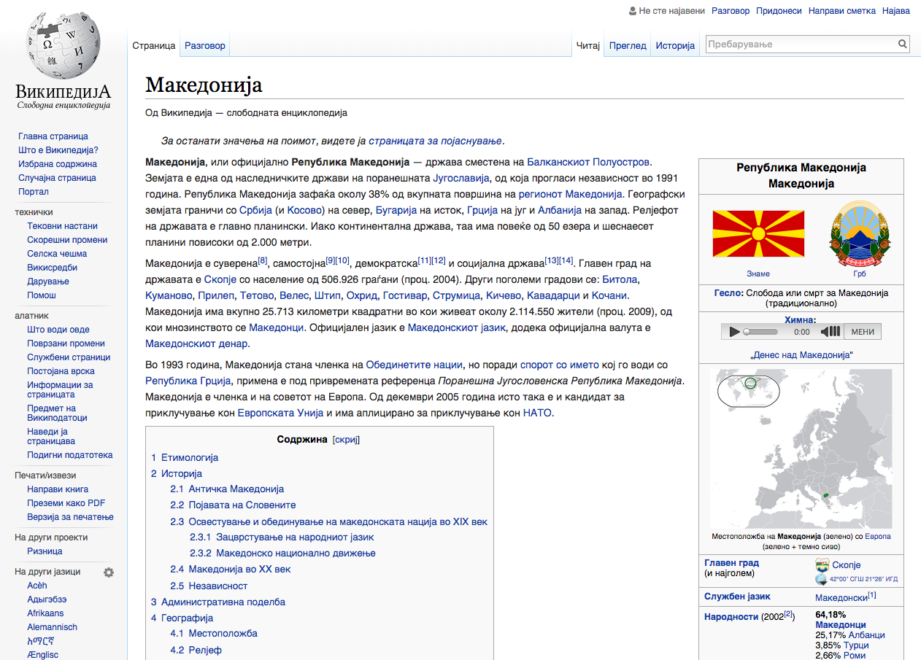
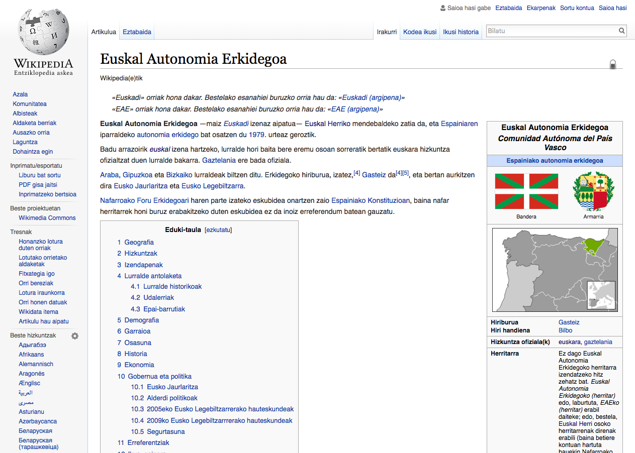
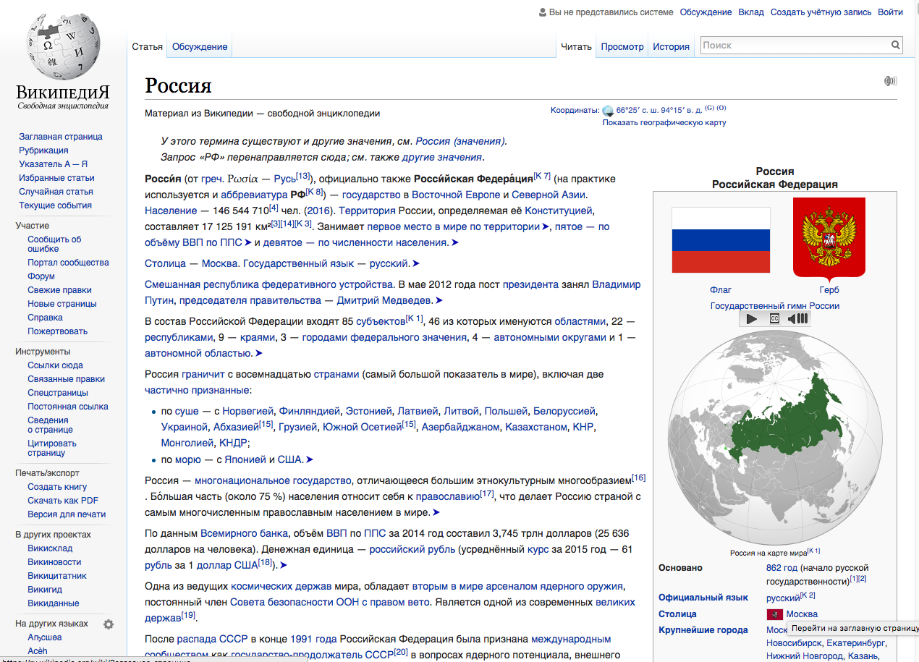
In my research:
I select the Cultural Context Content (CCC), i.e. the articles related to the editors’ cultural contexts in each language version (traditions, language, politics, agriculture, biographies, places, events, etcetera).
This means associating each language to the territories where it is spoken officially or where is native, and then, collecting articles that relate to each territory.
Notes:
In my research, I selected the content related to the cultural contexts of the editors from each language version, and then I studied characteristics such as topics and availability between linguistic versions, the editing activity, among others.
I found that the Cultural Context Content (CCC) represents on average a quarter of each Wikipedia language edition, dealing with topics such as culture, politics, people or geography of its speaking territories.

Slide 8
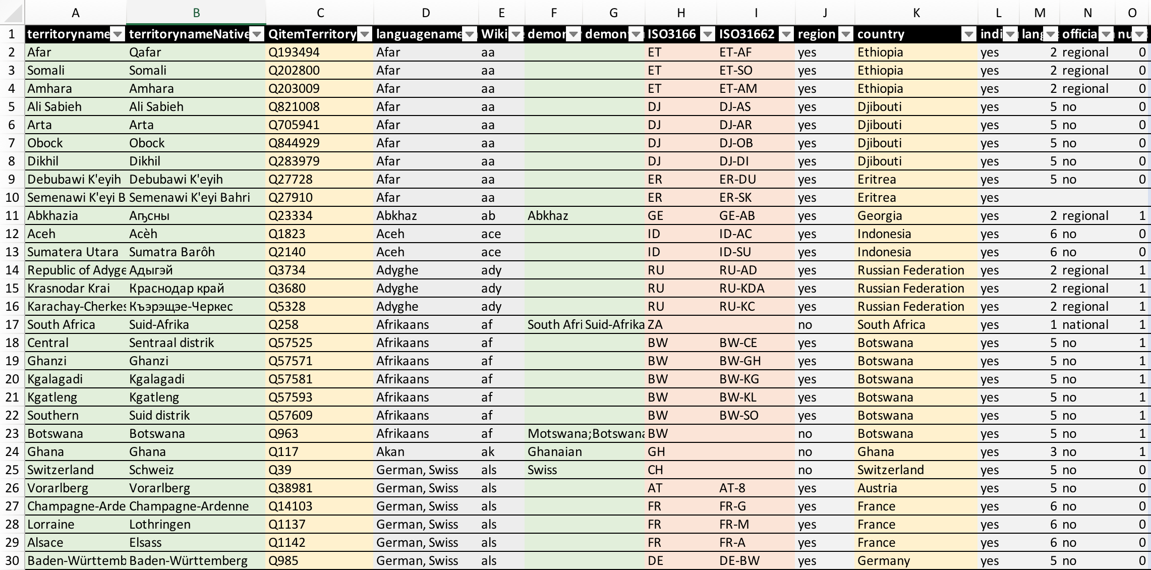
3. Methodology
This requires (i) creating a database with language territories mapping and (ii) employing different retrieval strategies to extract content from each language edition and label it as CCC.
(i) Wikidata Language Qitem, Language name, Language name in Native language, the ISO 639 code, the associated territories at country level (ISO 3166 code, English name, Native language name, demonym, Qitem) or at first subdivision (ISO 3166-2 code, English name, Native language name, demonym, Qitem) according to the information generated by Ethnologue.
My language territories mapping spreadsheet with 1783 rows.

Slide 9
(ii) The different retrieval strategies to extract content from each language edition and label it as CCC are the following.
I create a CCC dataset as rich as possible.
Wikipedia articles with characteristics such as:
Geolocation coordinates.
Specific keywords on their titles (language name, territory name, and demonym).
Contained in categories with keywords on their titles or in categories contained by these (in an iterative category graph crawling).
Wikidata Items that relate to groups of properties such as:
Language
Country
Part of
In relation with
…
Wikipedia MySQL db Replicas
Wikidata XML dump
Notes:
as this might help to see what is valuable in this language edition.

Slide 10
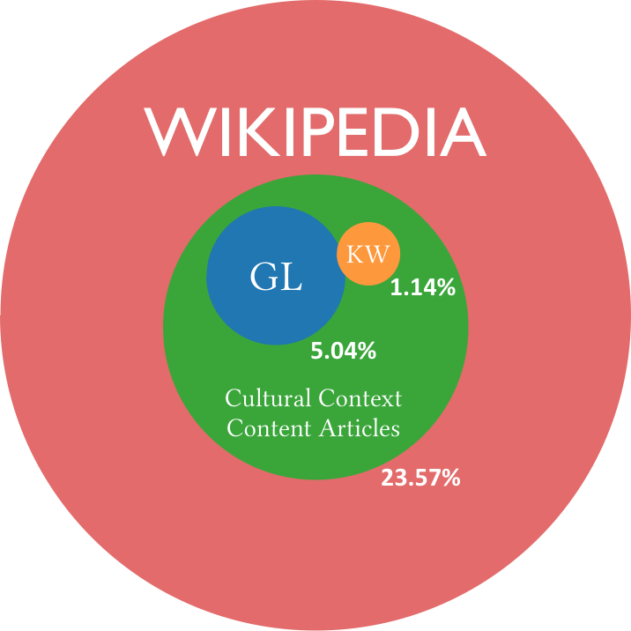
4. Results (Top language editions, October, 2016):
I used the first three of the mentioned strategies with 40 Wikipedia language editions (the first 30 in number of articles and 10 to increase diversity).
CCC articles were about a quarter of each Wikipedia language edition.

Slide 11
4.1 CCC Extent (African Languages, March, 2018):
LANGUAGE | LANGUAGE CODE | WP ARTICLES | CCC % | KW % | GL %
Afrikaans | af | 49118 | 24.77 | 0.97 | 14.15
Swahili | sw | 39844 | 19.34 | 0.46 | 2.35
Yoruba | yo | 31774 | 7.64 | 0.37 | 2.58
Amharic | am | 14689 | 2.08 | 0.19 | 1.14
Northern Sotho | nso | 7890 | 12.40 | 1.91 | 17.20
Somali | so | 5091 | 17.40 | 3.18 | 5.87
Shona | sn | 3633 | 11.62 | 0.85 | 1.49
Kinyarwanda | rw | 1930 | 5.70 | 1.50 | 1.24
Tongan | to | 1699 | 27.55 | 4.30 | 12.42
Wolof | wo | 1318 | 11.38 | 1.29 | 2.50
Oromo | om | 1011 | 32.05 | 4.45 | 7.52
Xhosa | xh | 993 | 1.21 | 0.50 | 2.11
Tswana | tn | 733 | 46.79 | 10.50 | 51.30

Slide 12
LANGUAGE | LANGUAGE CODE | WP ARTICLES | CCC % | KW % | GL %
Kirundi | rn | 706 | 4.96 | 0.85 | 26.77
Tsonga | ts | 658 | 13.22 | 2.58 | 0.61
Tumbuka | tum | 635 | 0.47 | 0.47 | 0.16
Twi | tw | 634 | 0.32 | 0.32 | 0.15
Sotho | st | 596 | 10.23 | 5.37 | 19.63
Swazi | ss | 462 | 13.64 | 3.25 | 6.49
Akan | ak | 445 | 0.45 | 0.45 | 14.16
Venda | ve | 326 | 11.96 | 2.76 | 10.12
Tigrinya | ti | 296 | 6.76 | 1.69 | 5.41
Sango | sg | 281 | 18.51 | 1.42 | 19.93
Afar | aa | 2 | 0.00 | 0.00 | 0.00
AVG. | - | 6865.17 | 12.52 | 2.07 | 9.39
African languages measured Cultural Context Content (CCC) accounted for about a 13%.
This is around half the percentage found for the top Wikipedias measured two years ago.

Slide 13

This 13% of CCC in African language editions is too little.
African Wikipedias are the ones who can explain how Africa is the best way.
CCC articles tend to be more developed. Editors tend to have more access to the sources of information, know the difference points of view on the same topic, among other reasons.

Slide 14
4.2 Culture Gap: the CCC articles not available across languages
About a 60% of the content language gaps are due to CCC.
Big languages like English or geographically close languages are the ones covering best the smaller languages.
How about the African languages?
Notes:
Most importantly, around a 50% of CCC articles are unique to each language version and do not exist in any other Wikipedia. The content language gap between versions is intrinsically linked to a culture gap, as it represents the most genuine part of the gap across languages.
I believe a minimal coverage of all other languages should be a goal on the agenda of each Wikipedia edition to create more multicultural (and complete) encyclopaedias.

Slide 15
How well are African CCC articles covered?
African languages CCC articles are not extensively covered even they are not many.

Slide 16
5. Activism (Creating lists of top priority articles)
Wikipedia Cultural Diversity Observatory (WCDO).
Prioritized translations. Automatically generate lists of 100 Vital articles for every language so they are the first that every other language should have.
These lists of Top 100 articles would ensure that each Wikipedia language edition has a minimal and strategical coverage of the whole available Wikipedia project cultural diversity.
I will ask the communities to generate a Top 100 Vital Articles lists from CCC.
https://meta.wikimedia.org/wiki/Grants:Project/Wikipedia_Cultural_Diversity_Observatory_(WCDO)
Notes:
One important solution is a list of articles for each Wikipedia language edition CCC by order of priority (algorithmically computed according to valuable metrics such as extension, quality and editor engagement metrics) which should exist in any other Wikipedia language edition. The list could highlight the first 100, although big Wikipedias may have more than 100 articles which should be reasonably present in all other languages.
This Top 100 in particular would ensure that each Wikipedia language edition has a minimal and strategical coverage of the whole available Wikipedia project cultural diversity.

Slide 17
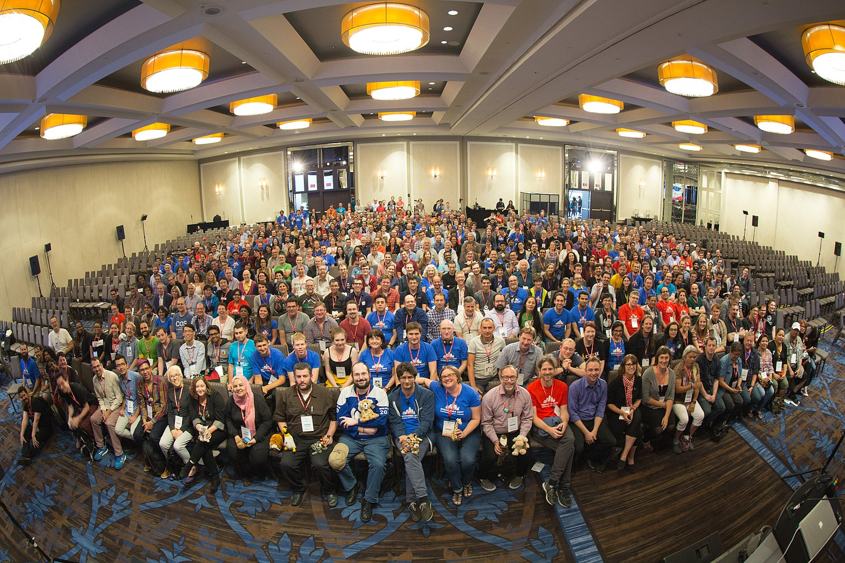
There is nothing more Wikimedian than multiculturality, embrace it and collaborate across languages.

Slide 18
Thank you very much!
Dr. Marc Miquel
{marcmiquel@gmail.com}
Username:marcmiquel
Pompeu Fabra University, Barcelona, Catalonia
Amical Wikimedia (Catalan Wikipedia)
March 18th 2018 Tunis

